Slide 1
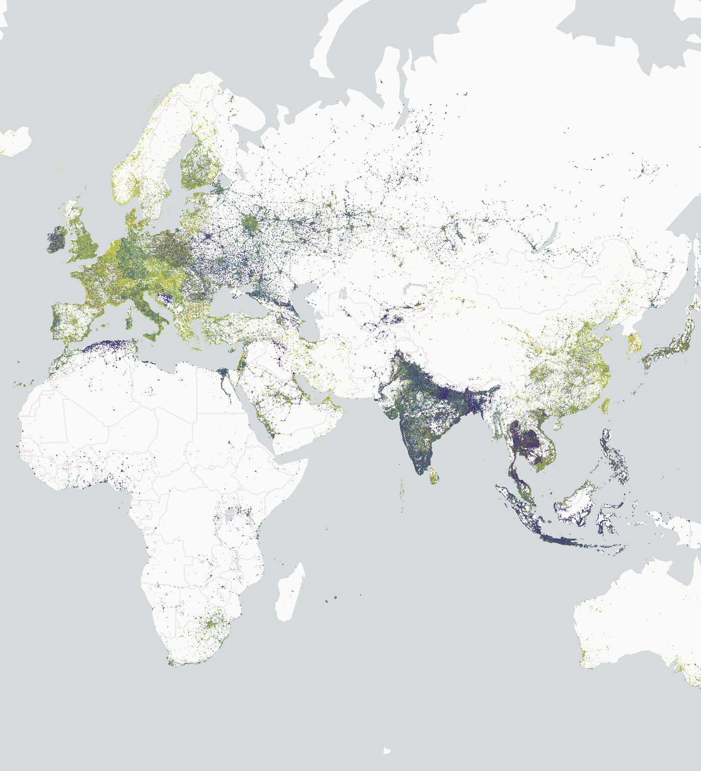
Cloud-Native Vector
Kyle Barron

Slide 2
What is Cloud-Native?
Understand part of the data without reading all of it
How? HTTP Range Requests
Cloud-Native Vector

Slide 3
What is Cloud-Native?
Range requests are not enough!
We need our data:
Spatially distributed
With a small unit of observation
Cloud-Native Vector

Slide 4
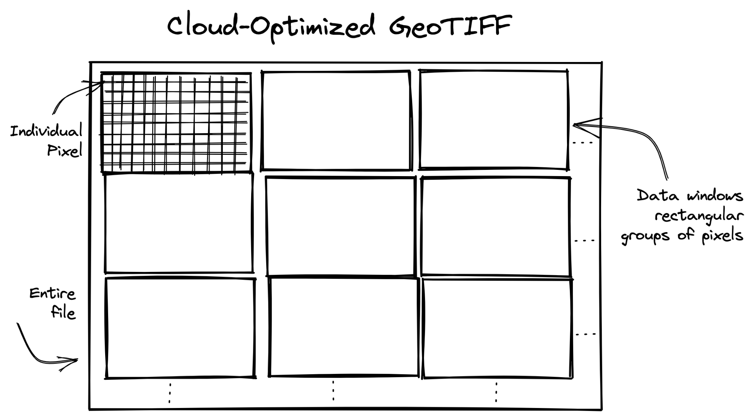
Cloud-Native Raster is Easy
Cloud-Native Vector
Pixels are small, regularly gridded
Notes:
“Come out swinging”
Cloud native raster is easy
Easy to split into spatially-related groups
Don’t need to work on how to split data
Can focus on implementations

Slide 5
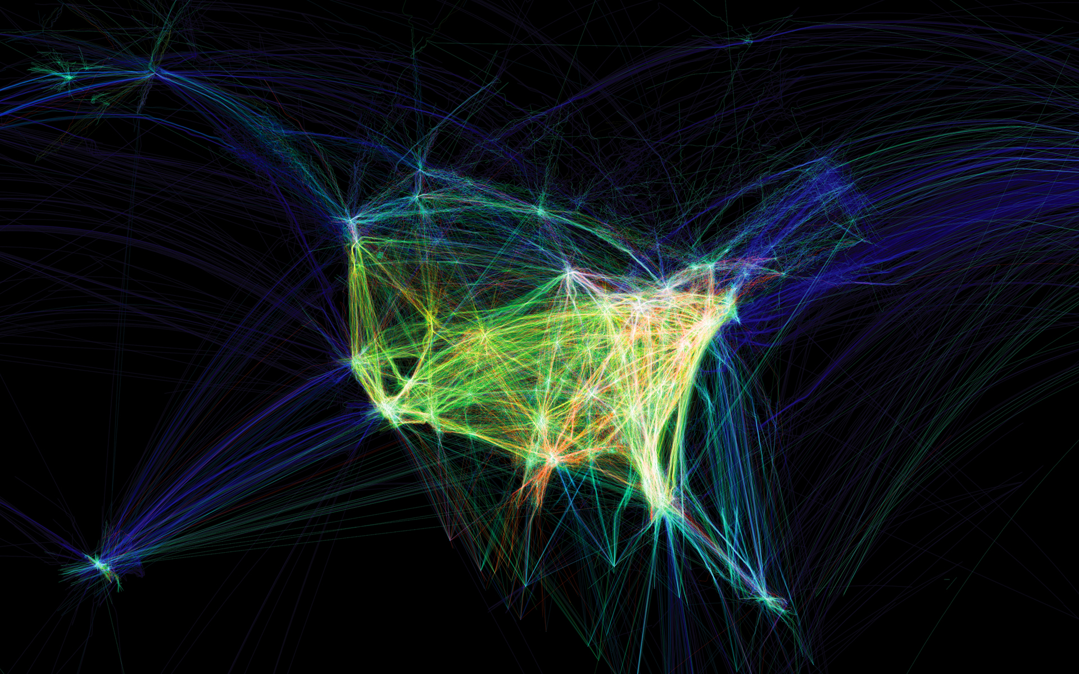
Cloud-Native Vector is Hard
Cloud-Native Vector
Image from
www.aaronkoblin.com/work/flightpatterns/
Geometries can be large and irregular
Notes:
No regular grid
Lots of variation of what a unit of observation can be
Have to first focus on how to group data

Slide 6
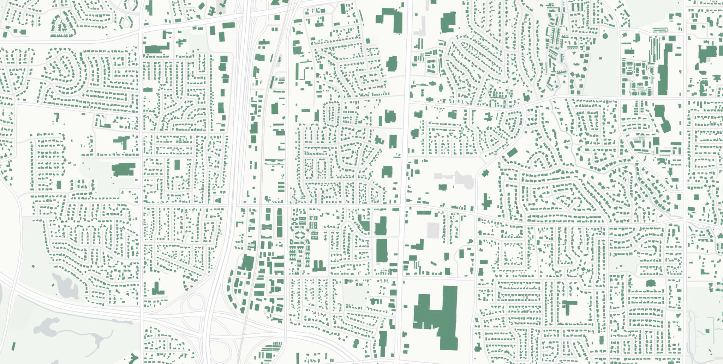
Cloud-Native Vector is Hard
Cloud-Native Vector
Efficient when relative size of items is small
Notes:
No regular grid
Lots of variation of what a unit of observation can be
Have to first focus on how to group data

Slide 7
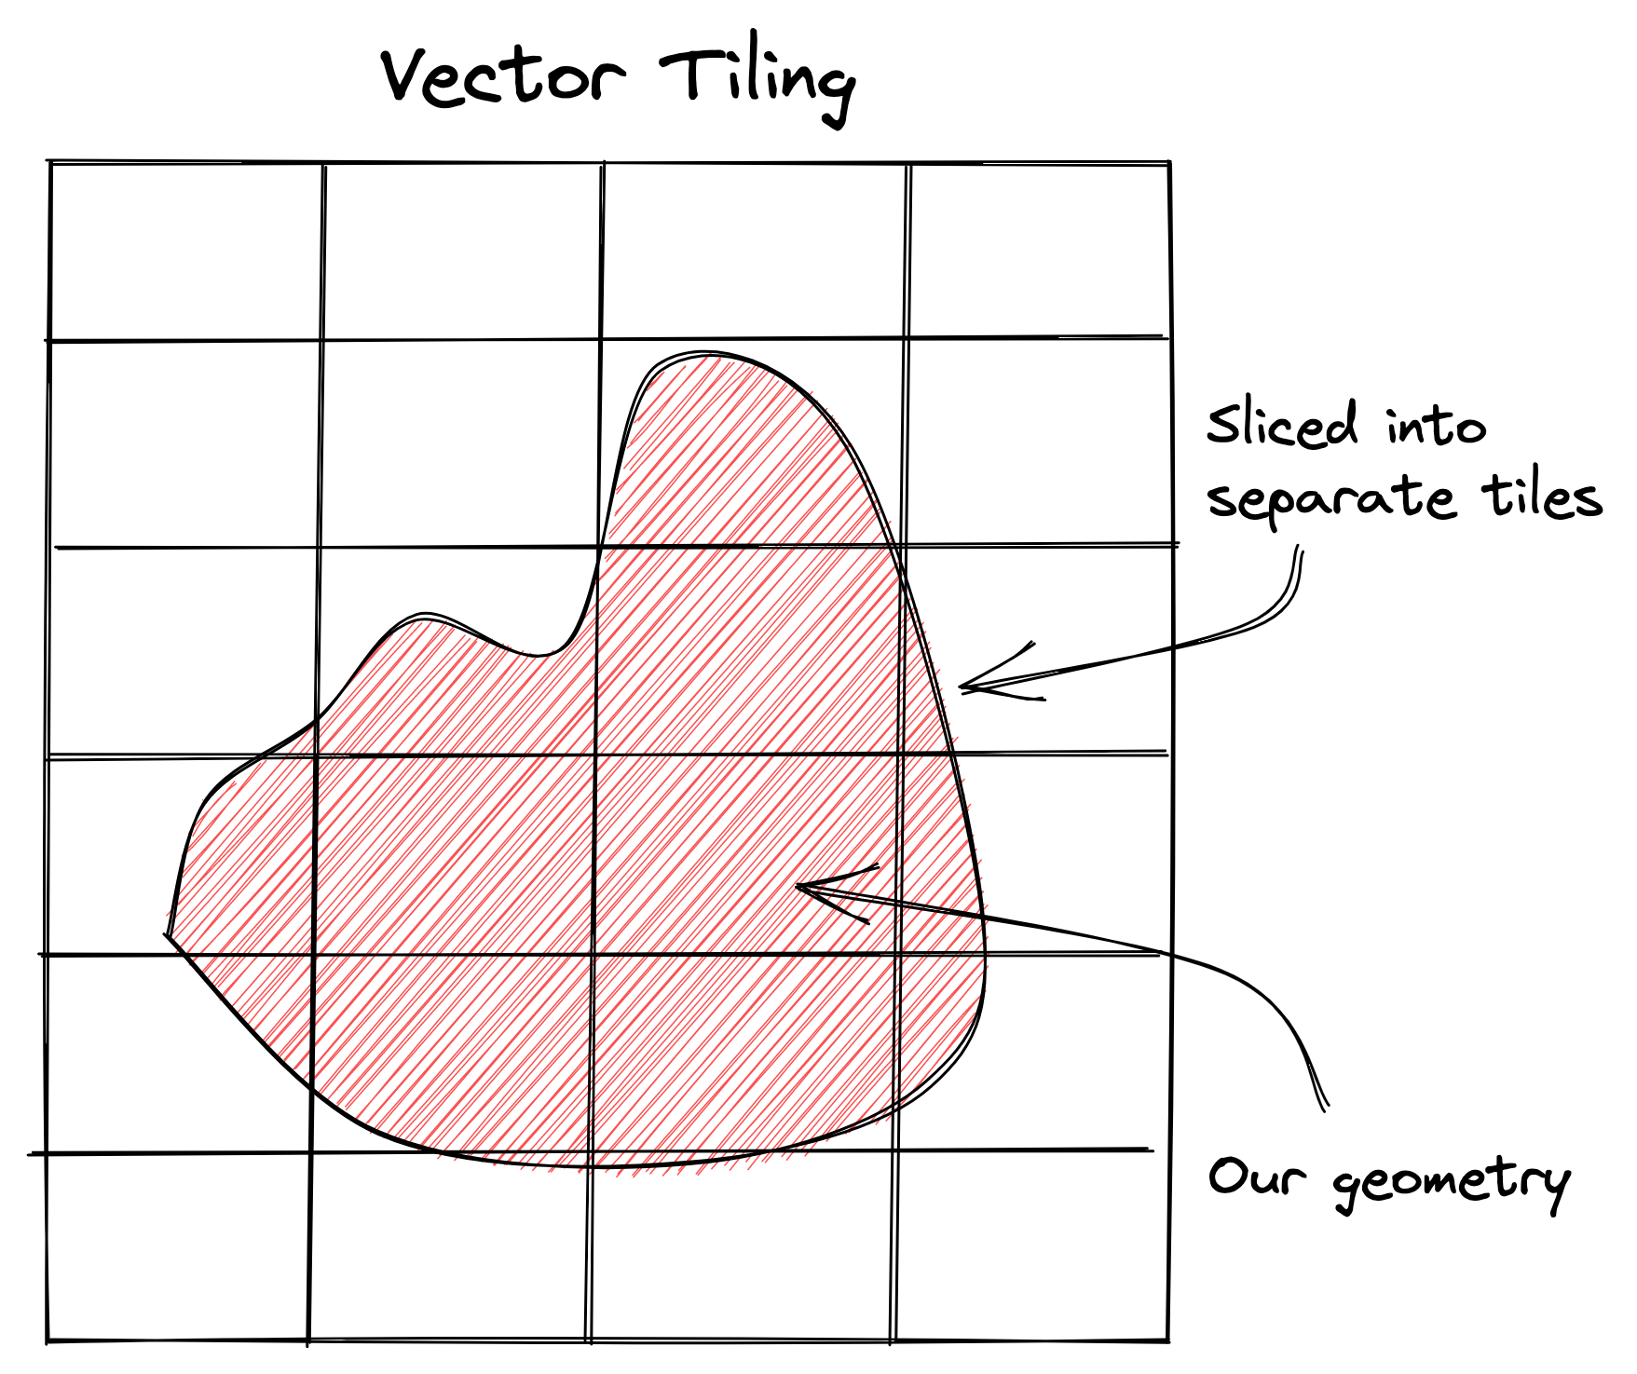
Vector Tiling
Cloud-Native Vector
Make our data small by cutting into pieces
Great for visualization
Difficult for analysis
https://github.com/protomaps/PMTiles

Slide 8
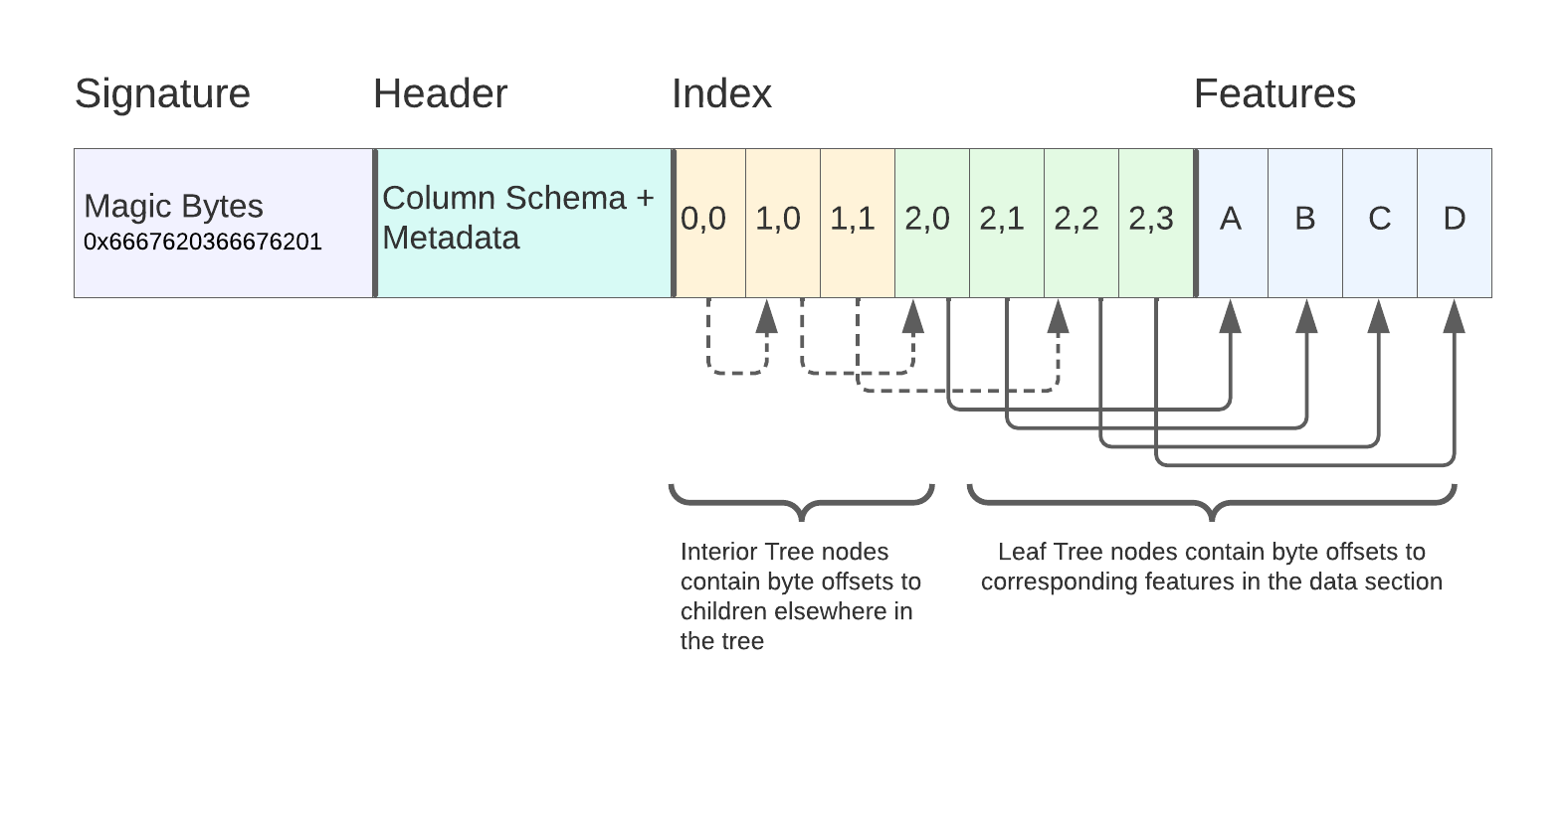
FlatGeobuf
Cloud-Native Vector
R-Tree spatial index
Row based data layout
No compression support
Image by Horace Williams
https://worace.works/2022/02/23/kicking-the-tires-flatgeobuf/
Notes:
Great for fetching only a couple rows
Bad for fetching a lot of data
If you want a lot of data in a small region,

Slide 9
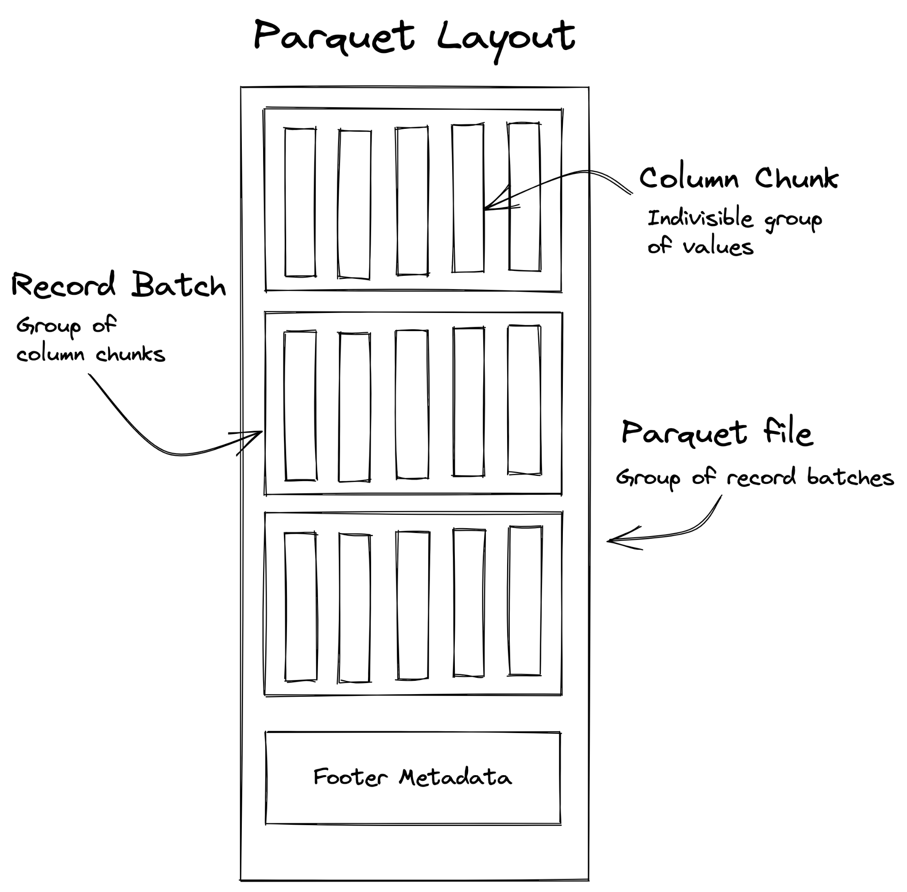
GeoParquet
Cloud-Native Vector
Chunked columnar format
Efficient compression + chunking
Learning from COG’s success
Huge ecosystem of existing Parquet tools
Notes:
Not efficient for getting a single row

Slide 10
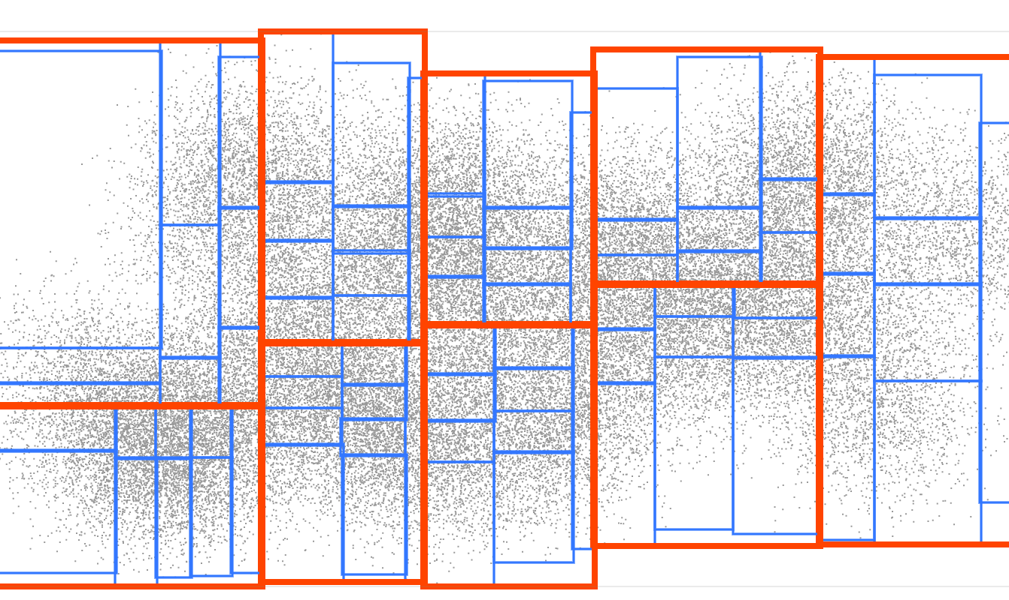
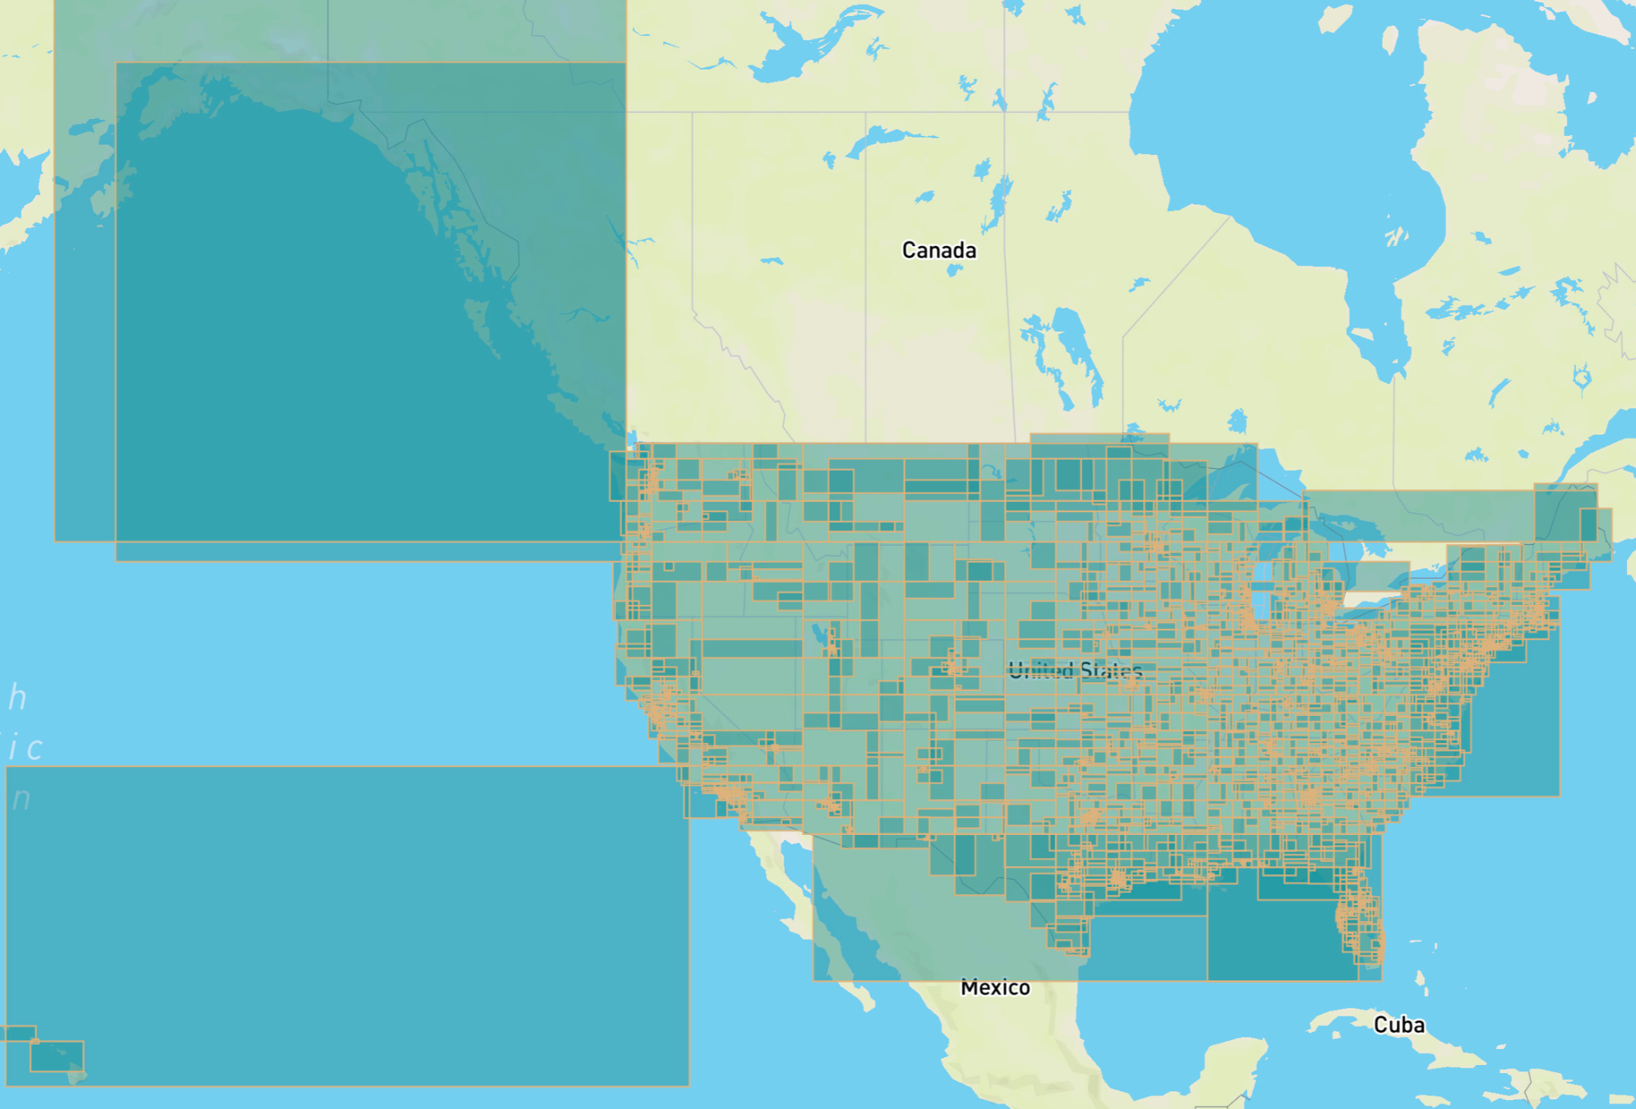
GeoParquet Spatial Indexing
Cloud-Native Vector
R-Tree Layout
Image by Vladimir Agafonkin
https://blog.mapbox.com/a-dive-into-spatial-search-algorithms-ebd0c5e39d2a
130M U.S. building footprints across 2000 partitions
Notes:
Great when you want to explore a lot of data in one region

Slide 11
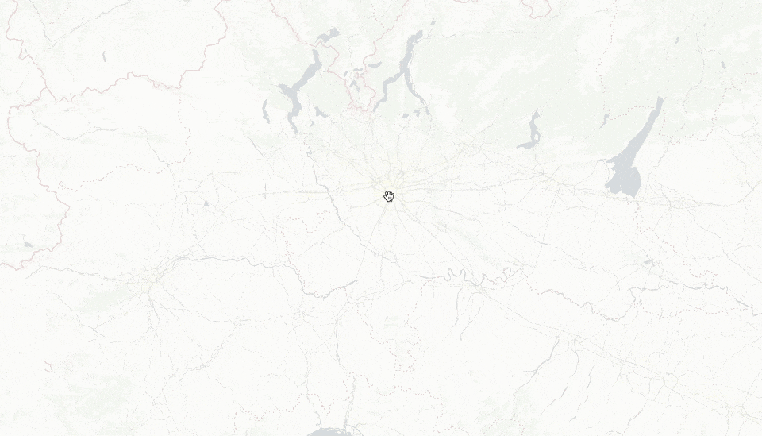
GeoParquet in deck.gl
3.2M Points
Examples
https://observablehq.com/@kylebarron/geoparquet-on-the-web

